Slide 1
EXCEL FINAL ASSESSMENT
EMPLOYEE ID: 4316
EMPLOYEE NAME: SURIYAPRIYA S

Slide 2
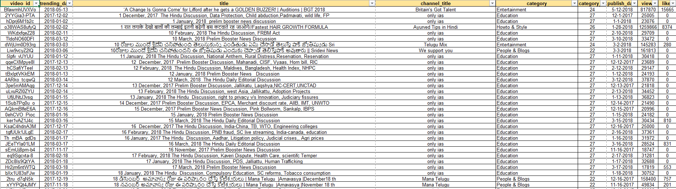
QUESTION 1

Slide 3
QUESTION 1
STEPS:
Remove duplicates using the remove duplicates option in the Data tools under Data tools
Fill blanks by computing the mean values.
Mean values are computed for numeric data and mode values are entered for categorical/text data.
FORMULA:
AVERAGE()
MEAN ()
MODE ()

Slide 4
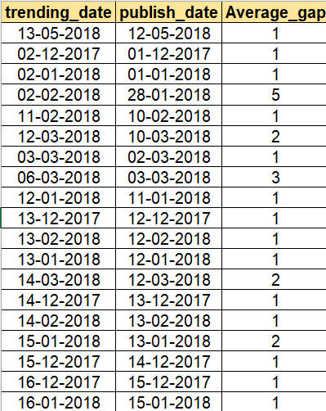

QUESTION 2

Slide 5
QUESTION 2
INFERENCE:
It takes about 2 days on an average for the videos to get trending after the publish date.
However, most videos get trended after 1 day which can be observed by computing the mode value.
FORMULA:
Average time gap =ABS(publish_date/trending_date)
Average = AVERAGE(C:C)
Mode = Mode(C:C)
STEPS:
Calculate the difference between both the dates using the function.
To calculate the average value and mode use the relevant functions.

Slide 6
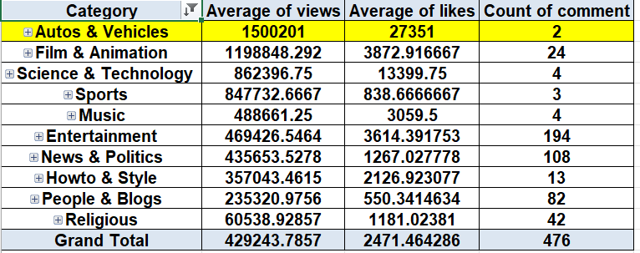
QUESTION 3

Slide 7
QUESTION 3
INFERENCE:
The autos and vehicles category has the highest number of views
STEPS:
Create a pivot table and put category on rows and average of likes, views and sum of comments on values field.
Using More sort options, sort from descending to ascending order based on the average of views and on value filters select top 10 to get the highest 10 categories.

Slide 8
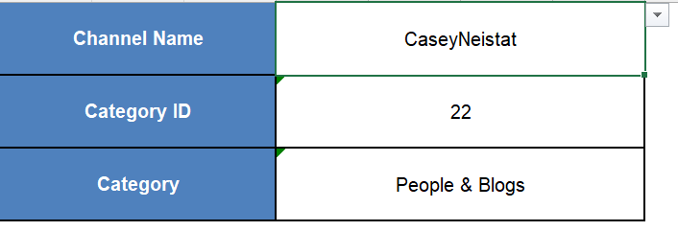
QUESTION 4

Slide 9
QUESTION 4
FORMULA:
=XLOOKUP(E1,'YouTube data'!D7:D16203,'YouTube data'!E7:E16203,"NA",0)
=XLOOKUP(XLOOKUP(E1,'YouTube data'!D7:D16203,'YouTube data'!E7:E16203,"NA",0),Category!A:A,Category!B:B,"na")
STEPS:
Create Column Headers as channel name, Category ID, and category.
Add Data validation to the channel name cell to give corresponding values accordingly.
Using Xlookup, find the category ID based on the channel name.
Using Xlookup again, find the category name corresponding to the category ID.

Slide 10
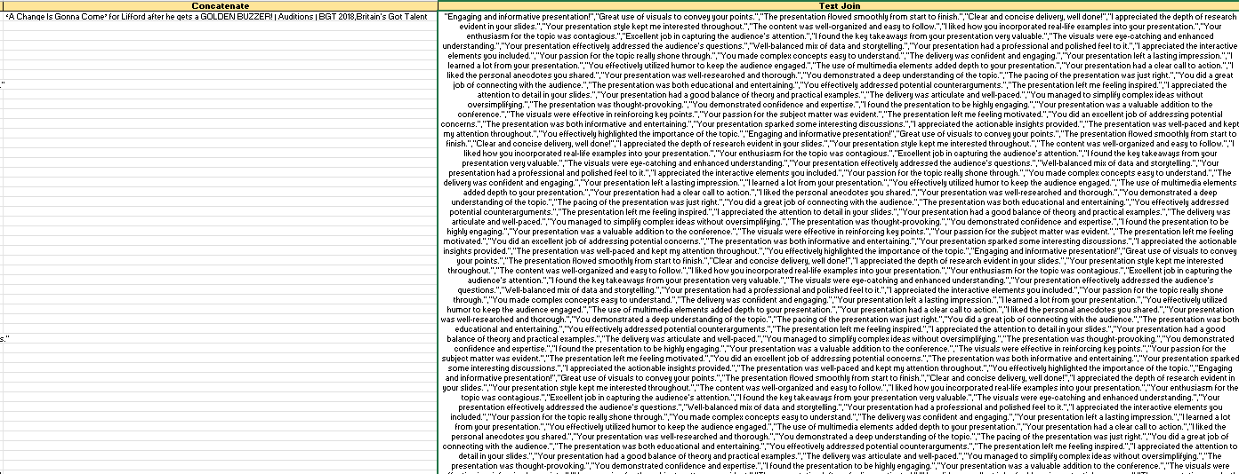
QUESTION 5

Slide 11
QUESTION 5
FORMULA:
=CONCAT(A2,",",B2)
=TEXTJOIN(",",TRUE,C2:C593)
STEPS:
Use the function Concat
Use text join to get all comments of one video in a single cell and click wrap text and merge cells

Slide 12
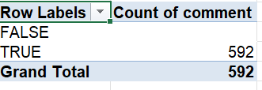
QUESTION 6

Slide 13
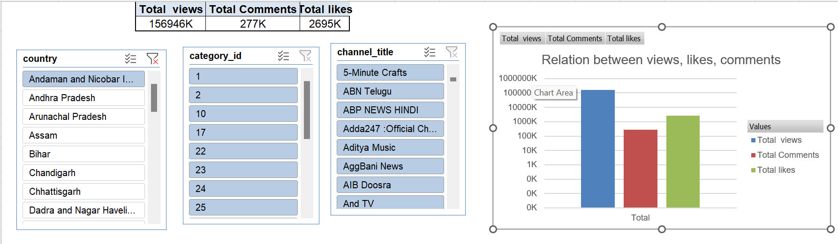
QUESTION 7

Slide 14
QUESTION 5
INFERENCE:
The views are high, then comes

Slide 15
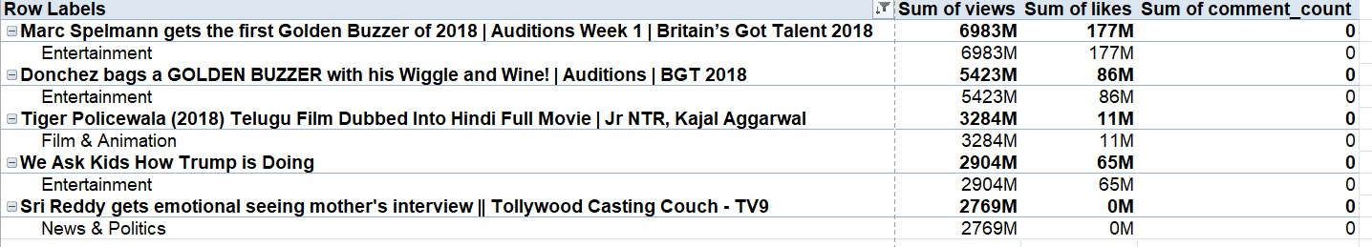
QUESTION 8

Slide 16
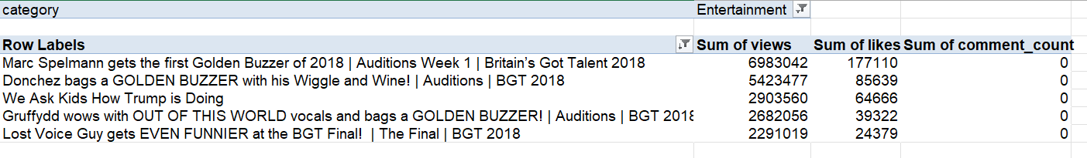
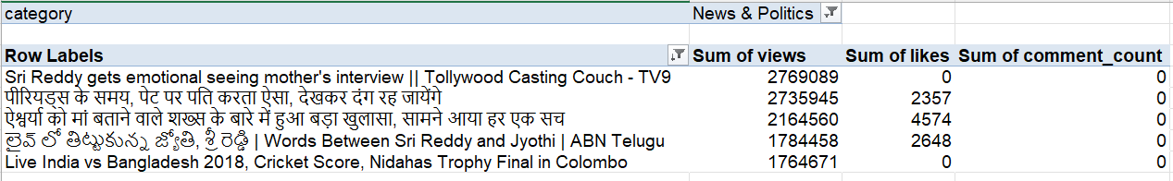
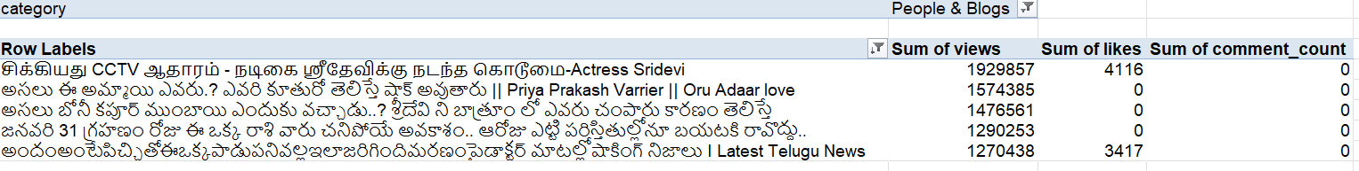
QUESTION 8

Slide 17
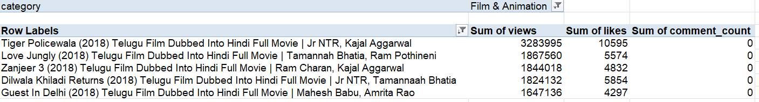
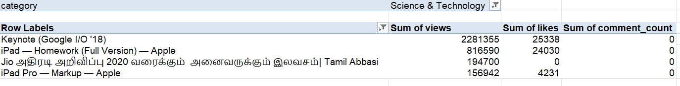

Slide 18
QUESTION 8
STEPS:
Category wise engagement metrics can be calculated through filters
Add the category field in filter and add the other engagement metrics fields such as views, likes in values.

Slide 19

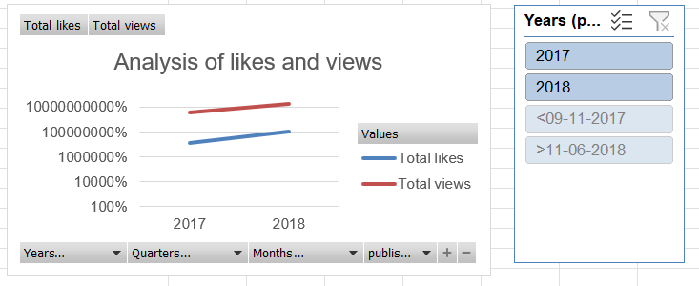
QUESTION 10

Slide 20
QUESTION 10
INFERENCE:
The year 2018 has the highest number of views compared with 2017.
It can be visualized in the line chart.

Slide 21
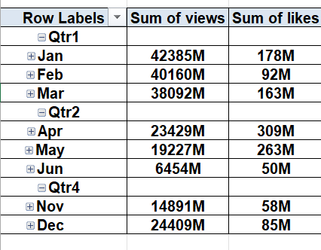
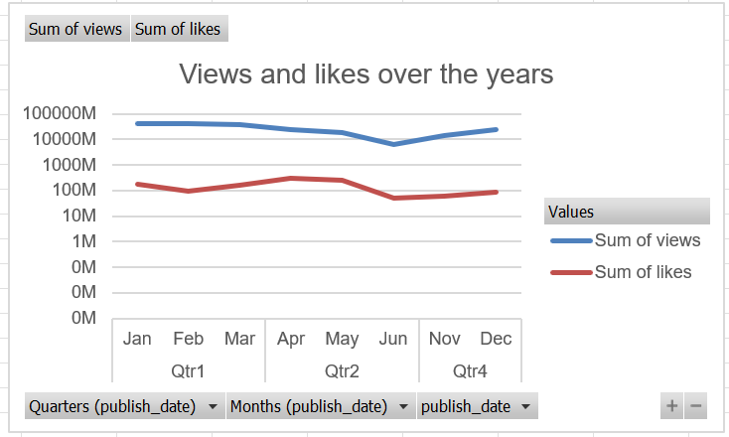
QUESTION 11

Slide 22
QUESTION 11
INFERENCE:
There is a drop in the views and likes in the quarter 2
It faces a steady rise over the next few quarters and reaches peak at quarter 4

Slide 23
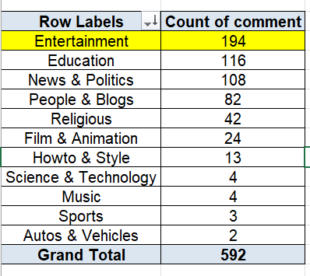
QUESTION 13

Slide 24
QUESTION 5
Inference:
Entertainment has huge comments
Auto and vehicles has the least

Slide 25
QUESTION 14
INFERENCE:
The entertainment category stands the first.
Autos and vehicles has the lowest number of comments

Slide 26
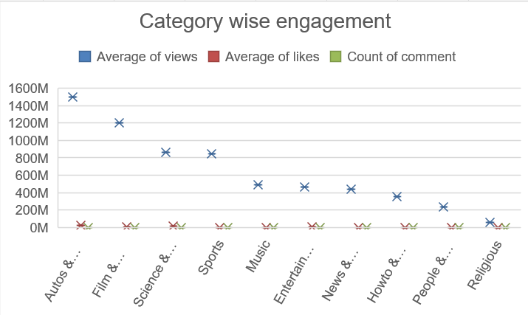
QUESTION 14

Slide 27
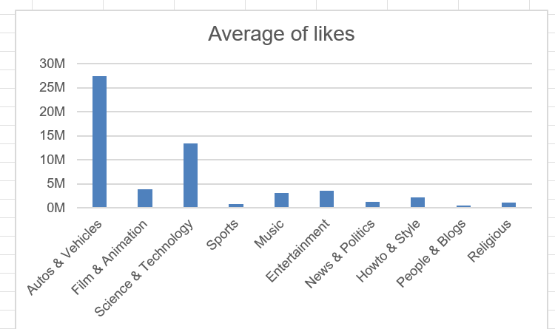
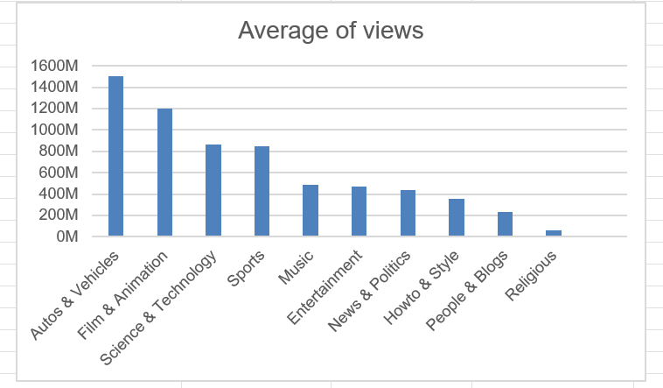
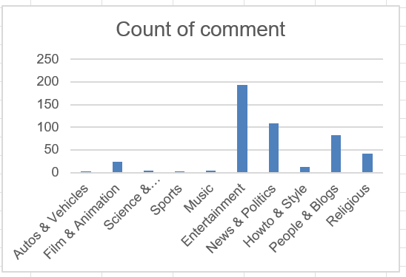

Slide 28
QUESTION 14
INFERENCE:
The autos and vehicles category has the highest number of views and stands the first in both views and likes.
However in the comments, entertainment category stands the first.

Slide 29
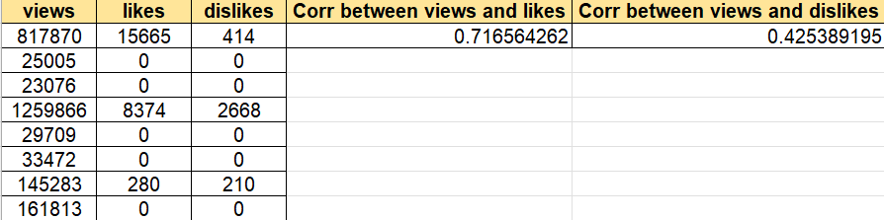
QUESTION 15

Slide 30
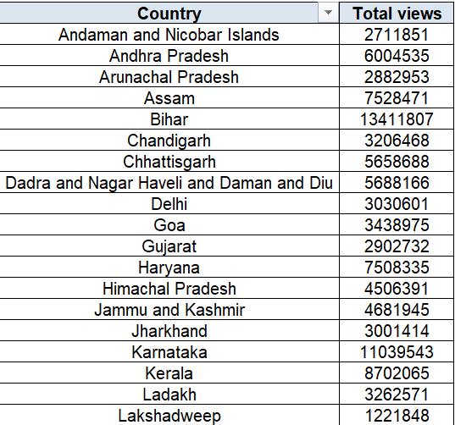
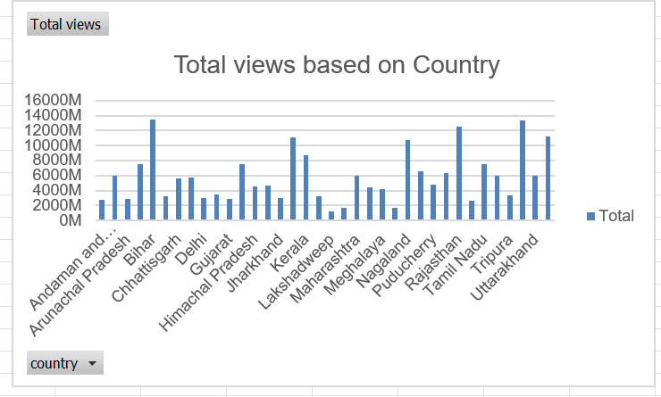
QUESTION 16

Slide 31
QUESTION 16
INFERENCE:
Almost all the states have equal distribution.
Andaman and Nicobar stands the first

Slide 32
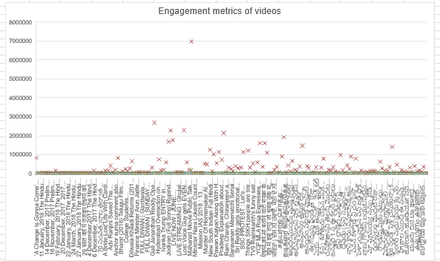
QUESTION 17
Outlier

Slide 33
QUESTION 17
INFERENCE:
The outliers are clearly visible in the box plot

Slide 34
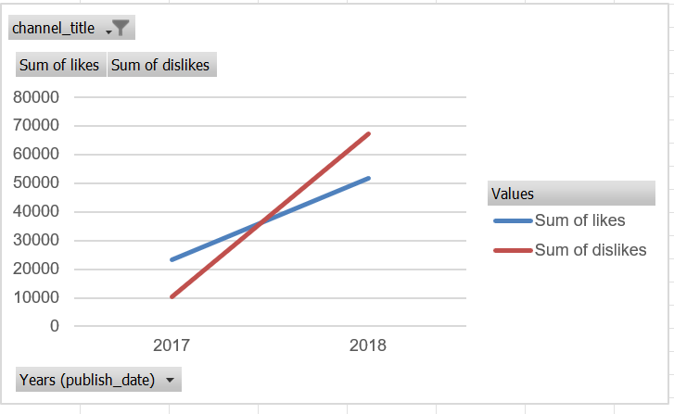
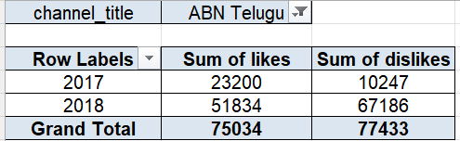
QUESTION 18

Slide 35
QUESTION 18
INFERENCE:
There is a sharp increase in the sum of likes and dislikes over the years
It can be clearly visible in the line chart
Both likes and dislikes were high in 2018

Slide 36
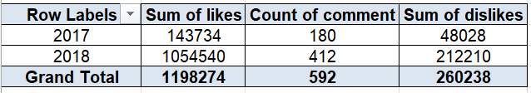
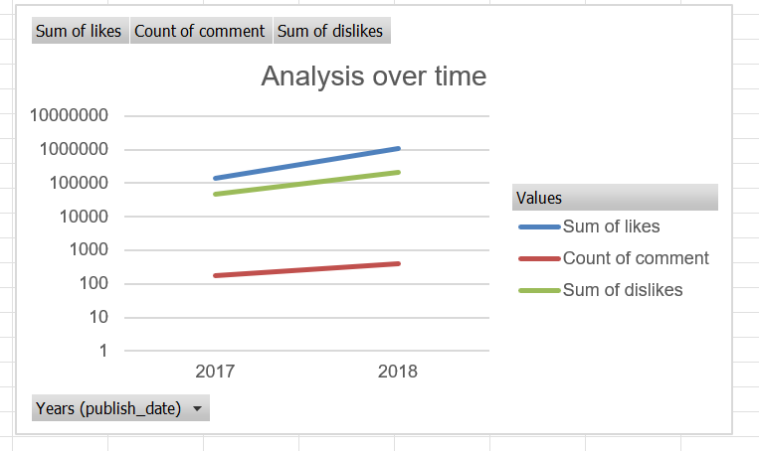
QUESTION 19

Slide 37
QUESTION 19
INFERENCE:
There is a slight rise in the likes, dislikes and comments over the years
It is observed that in 2018 there is a rise in all these engagement metrics

Slide 38
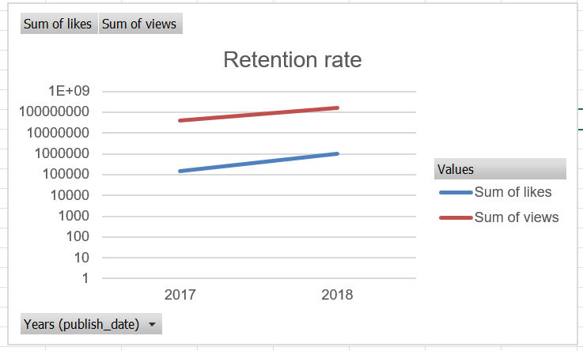
QUESTION 20

Slide 39
QUESTION 20
INFERENCE:
The retention rate has a rise over the years from 2017 to 2018. The metrics has faced an increase over the years.

Slide 40
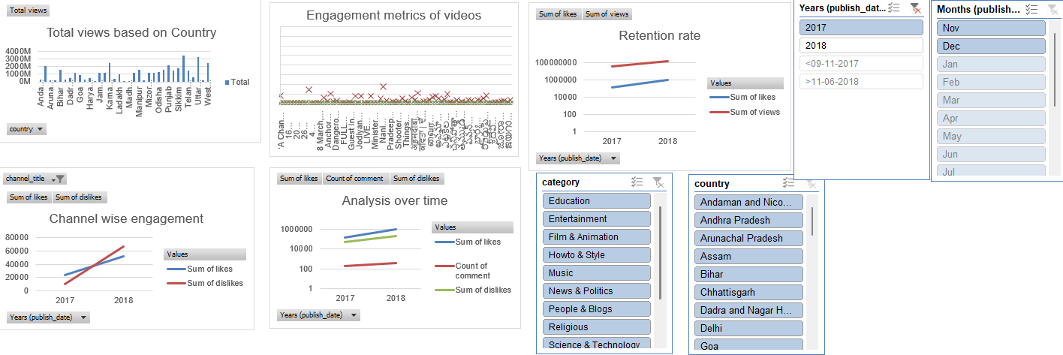
DASHBOARD

